Slide 1
COMP0104 Software Development Practice: Distributed Version Control (GIT)
Jens Krinke
Centre for Research on Evolution, Search & Testing Software Systems Engineering Group Department of Computer Science University College London

Slide 2
GIT
Comparison with SUBVERSION
Distributed Version Control
Basic Work Cycle
How GIT works

Slide 3
SUBVERSION: Basic Work Cycle
Update your working copy svn update
Make changes svn add/delete/copy/move
Examine your changes svn status/diff
Resolve conflicts svn update/resolve
Commit your changes svn commit

Slide 4
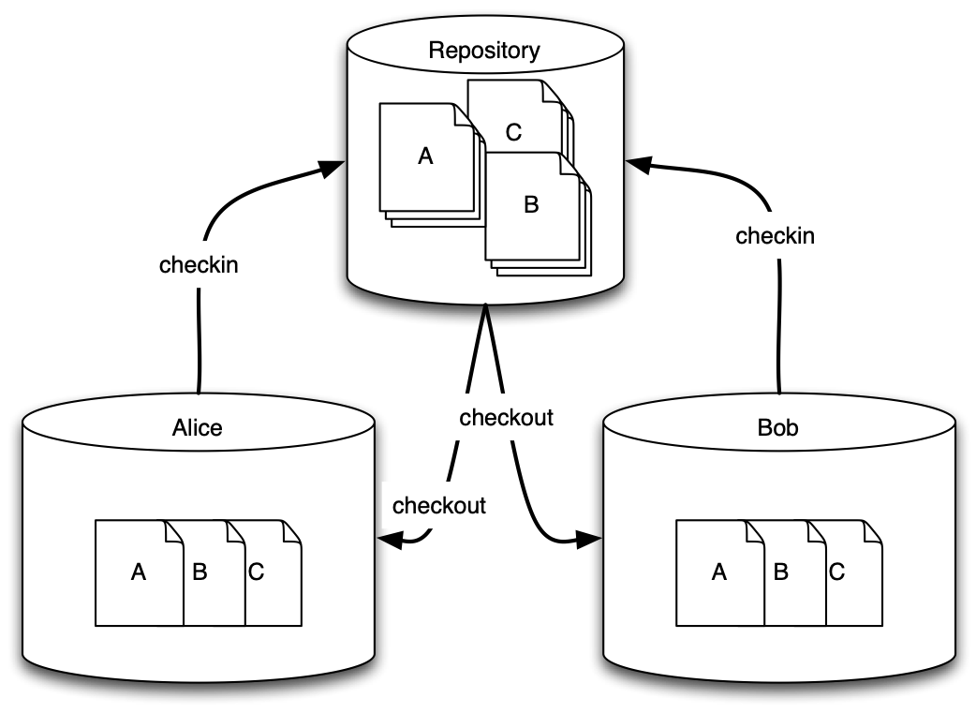
CVS

Slide 5
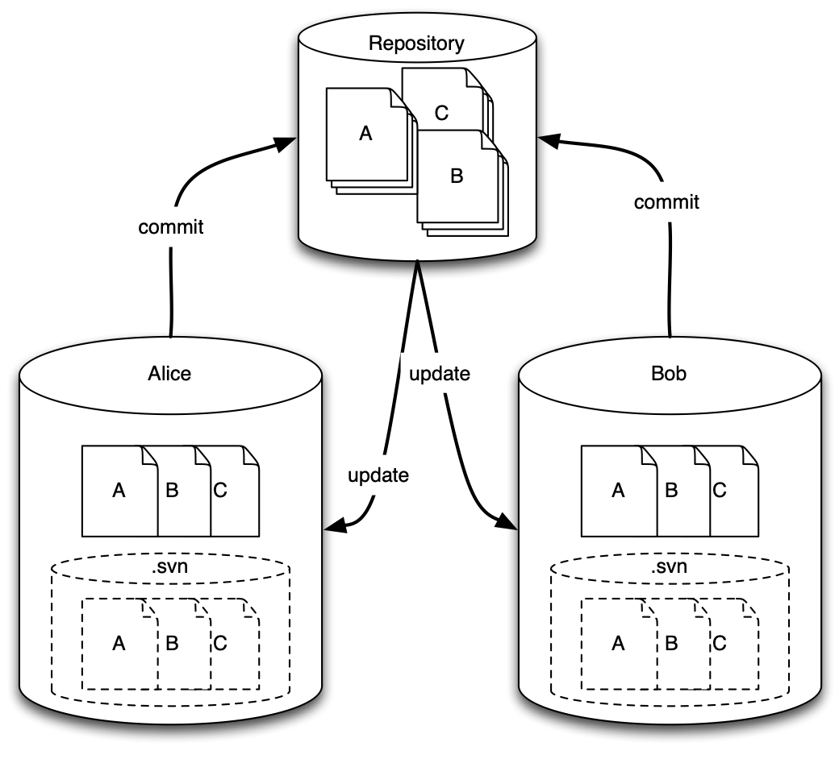
SUBVERSION

Slide 6
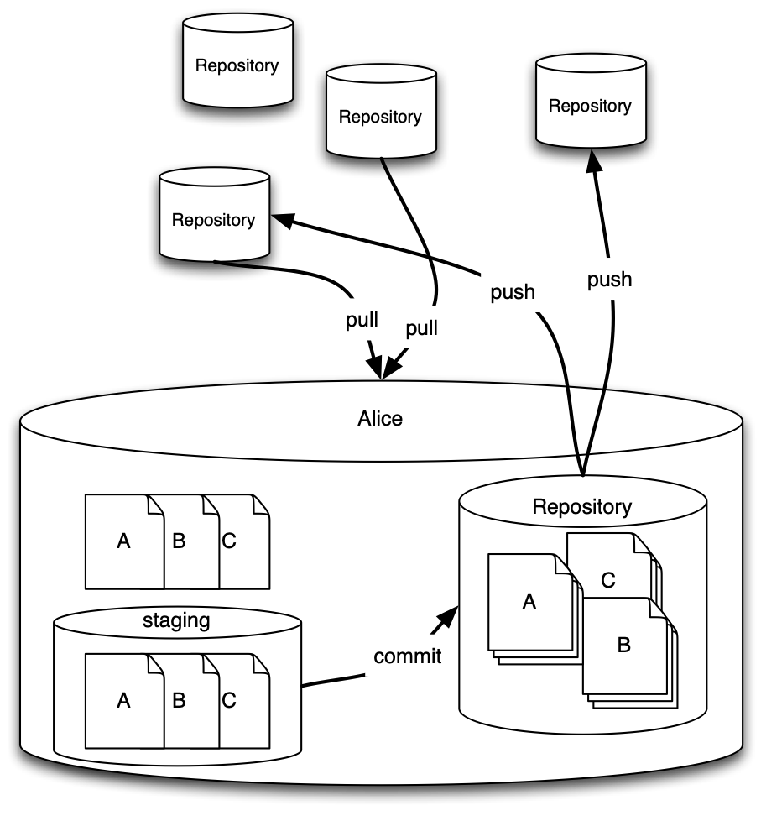
GIT:
Distributed
Repositories

Slide 7
Distributed Version Control
Almost everything is local
Almost every operation is fast
Almost every cloned repository is a backup
Almost every operation works offline
Almost all repositories have the full history

Slide 8
GIT’s Special: The Staging Area
Unlike other version control systems, GIT has a concept of the staging area (index)
These are changes which will be committed.
The staging area can be used to prepare for the commit.

Slide 9
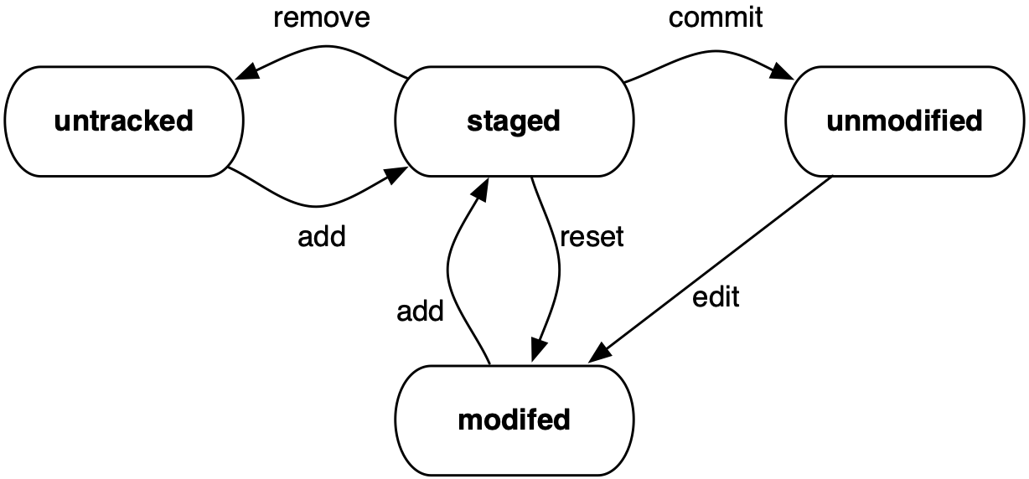
File Status Lifecycle

Slide 10
Setup
Introduce yourself to GIT: $ git config --global user.name “John Doe” $ git config --global user.email “j.doe@ucl.ac.uk" $ _

Slide 11
The first repository
% git init comp0104 Initialized empty Git repository in /home/doe/comp0104/.git/
% cd comp0104
% git status # On branch master # # Initial commit # nothing to commit (create/copy files and use "git add" to track)

Slide 12
Create a File
File Status: untracked
% vi README
% git status # On branch master # # Initial commit # # Untracked files: # (use "git add <file>..." to include in what will be committed) # # README nothing added to commit but untracked files present (use "git add" to track)

Slide 13
Add a File to the Stage
File Status: staged (added)
% git add README
% git status # On branch master # # Initial commit # # Changes to be committed: # (use "git rm --cached <file>..." to unstage) # # new file: README #

Slide 14
Commit the Changes
File Status: unmodified
% git commit -m 'Initial commit.' [master (root-commit) 8a5e2f0] Initial commit. 1 file changed, 1 insertion(+) create mode 100644 README
% git status # On branch master nothing to commit (working directory clean)

Slide 15
File Status: modified
% vi be
% vi README
% git add be

Slide 16
File Status: modified
% git status # On branch master # Changes to be committed: # (use "git reset HEAD <file>..." to unstage) # # new file: be # # Changes not staged for commit: # (use "git add <file>..." to update what will be committed) # (use "git checkout -- <file>..." to discard changes in working directory) # # modified: README #

Slide 17
git diff
Differences between working area and stage
% git diff diff --git a/README b/README index 9dd26d5..e0f254c 100644 --- a/README +++ b/README @@ -1 +1,2 @@ This is an example project for GIT. +It contains a file with british english text.
% _

Slide 18
The Stage is not final (status before a change)
% git add README
% git status # On branch master # Changes to be committed: # (use "git reset HEAD <file>..." to unstage) # # modified: README # new file: be #

Slide 19
The Stage is not final (change)
% vi README
% git diff diff --git a/README b/README index e0f254c..5e53579 100644 --- a/README +++ b/README @@ -1,2 +1,2 @@ This is an example project for GIT. -It contains a file with british english text. +It contains a file with a british english text.

Slide 20
The Stage is not final (status after change)
% git status # On branch master # Changes to be committed: # (use "git reset HEAD <file>..." to unstage) # # modified: README # new file: be # # Changes not staged for commit: # (use "git add <file>..." to update what will be committed) # (use "git checkout -- <file>..." to discard changes in working directory) # # modified: README #

Slide 21
Accessing stage and repository
stage : repository
% git diff --staged README diff --git a/README b/README index 9dd26d5..e0f254c 100644 --- a/README +++ b/README @@ -1 +1,2 @@ This is an example project for GIT. +It contains a file with british english text.
% _

Slide 22
Accessing stage and repository
workspace : stage
% git diff README diff --git a/README b/README index e0f254c..5e53579 100644 --- a/README +++ b/README @@ -1,2 +1,2 @@ This is an example project for GIT. -It contains a file with british english text. +It contains a file with a british english text.
% _

Slide 23
Accessing stage and repository
workspace : repository
% git diff -r master README diff --git a/README b/README index 9dd26d5..5e53579 100644 --- a/README +++ b/README @@ -1 +1,2 @@ This is an example project for GIT. +It contains a file with a british english text.
%

Slide 24
git commit
% git commit
Introduced british english.
# Please enter the commit message for your changes. Lines starting
# with '#' will be ignored, and an empty message aborts the commit.
# On branch master
# Changes to be committed:
# (use "git reset HEAD <file>..." to unstage)
#
# modified: README
# new file: be
#
# Changes not staged for commit:
# (use "git add <file>..." to update what will be committed)
# (use "git checkout -- <file>..." to discard changes in working directory)
#
# modified: README
#

Slide 25
git log
% git log commit 5f43cee4b5ad7684477828c1a3b8b84c3d345539 Author: John Doe <john@doe.org> Date: Sat Jan 12 17:42:44 2013 +0000 Introduced british english. commit 8a5e2f02ff6ff4fec8cadd0c4028ffe0f822a6e5 Author: John Doe <john@doe.org> Date: Sat Jan 12 17:00:02 2013 +0000 Initial commit.
% _

Slide 26
Working with multiple repositories (local)
% cd ..
% git clone comp0104 comp0104us Cloning into 'comp0104us'... done.
% cd comp0104us
% git status # On branch master nothing to commit (working directory clean)

Slide 27
Skipping staging
% vi be
% git commit -a -m 'Created american version.' [master 0b5a44f] Created american version. 1 file changed, 4 insertions(+), 2 deletions(-)
% vi README
% git commit -a -m 'Updated README file.' [master f422033] Updated README file. 1 file changed, 1 insertion(+), 1 deletion(-)

Slide 28
Renaming files
% git mv be ae
% git commit -m 'Changed file name.' [master 266abb7] Changed file name. 1 file changed, 0 insertions(+), 0 deletions(-) rename be => ae (100%)

Slide 29
Working with multiple repositories
% cd ../comp0104
% git status -s M README
% git add README
% git commit -m 'Improved spelling.' [master febe05c] Improved spelling. 1 file changed, 1 insertion(+), 1 deletion(-)

Slide 30
Working with multiple repositories
git pull
% cd ../comp0104us
% git pull remote: Counting objects: 5, done. remote: Compressing objects: 100% (3/3), done. remote: Total 3 (delta 0), reused 0 (delta 0) Unpacking objects: 100% (3/3), done. From /home/doe/comp0104 5f43cee..febe05c master -> origin/master Auto-merging README CONFLICT (content): Merge conflict in README Automatic merge failed; fix conflicts and then commit the result.

Slide 31
Resolving conflicts
% vi README
% git add README
% git commit -m 'Integrated changes.' [master aed3adc] Integrated changes.
This is an example project for GIT.
<<<<<<< HEAD
It contains a file with american english text.
=======
It contains a file with a british english text.
>>>>>>> febe05cff0734d7dda529fbd761b599297bb86c9

Slide 32
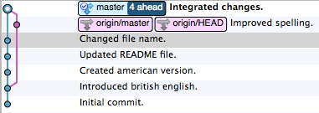
History
% git log --graph --decorate --pretty=oneline --abbrev-commit * aed3adc (HEAD, master) Integrated changes. |\ | * febe05c (origin/master, origin/HEAD) Improved spelling. * | 266abb7 Changed file name. * | f422033 Updated README file. * | 0b5a44f Created american version. |/ * 5f43cee Introduced british english. * 8a5e2f0 Initial commit.
%

Slide 33
Cloning a remote repository
% git clone https://github.com/jkrinke/comp0104gitexmp.git Cloning into 'comp0104gitexmp'... remote: Counting objects: 10, done. remote: Compressing objects: 100% (8/8), done. remote: Total 10 (delta 0), reused 10 (delta 0) Unpacking objects: 100% (10/10), done.
% cd comp0104gitexmp
%

Slide 34
Updating a remote repository
% vi README
% git commit -a -m 'Added a reference to UCL.' [master 981374f] Added a reference to UCL. 1 file changed, 1 insertion(+)
% git push Username for 'https://github.com': jkrinke Password for 'https://jkrinke@github.com': To https://github.com/jkrinke/comp0104gitexmp.git febe05c..981374f master -> master

Slide 35
Updating local repository
% git pull remote: Counting objects: 5, done. remote: Compressing objects: 100% (2/2), done. remote: Total 3 (delta 1), reused 3 (delta 1) Unpacking objects: 100% (3/3), done. From https://github.com/jkrinke/comp0104gitexmp febe05c..981374f master -> origin/master Updating febe05c..981374f Fast-forward README | 2 +- 1 file changed, 1 insertion(+), 1 deletion(-)

Slide 36
Pull
Adding the changes from other repositories to the local repository.
Merges are usually automatic.
Conflicts will occur, but relatively easy to deal with.

Slide 37
Push
Propagating (local) changes to other repositories.
Not all changes need to be pushed.
Push can be replaced by pull.
Propagating outside push/pull:
GIT can create patches
GIT can integrate patches

Slide 38
Branching and Merging
Branching and merging is simple in git.
Branches of often temporary.
Branching is encouraged.
Merging is mainly automatic.
However, branching can cause problems due to conflicts at merge.
Resolving conflicts without tool support is painful.
One should adapt a defined workflow.

Slide 39
Creating Branches git branch name
Branches are created from the current branch.
To commit to a branch, it has to be checked out (git checkout name)
If a branch is no longer needed, it can be deleted.
Checkout a branch to switch to it in the same workspace.

Slide 40
Branching
Bug fix
Master
Master
Devel
Devel
Devel
Devel
Feat.

Slide 41
Merging Branches git merge name
A branch can be merged into the current one via fast-forward or 3-way merge.
The current branch will contain the merge result.
3-way merge occurs between the current state of the two branches and the common ancestor.
A fast-forward is only possible if the current branch has not been changed.

Slide 42
Merging
Bug fix
Master
Master
Master
Devel
Devel
Feat.

Slide 43




Rebasing: Reapply commits on top of another commit
Bug fix
Master
Devel

Slide 44


















Git flow A standard workflow for git
feature branches
develop
release branches
hotfixes
master
Time
Tag
0.1
Severe bug fixed for production:
hotfix 0.2
Major feature for next release
Best practice
Suitable for large teams large products
Based on two main branches for development and releases
Feature for future release
Incorporate bugfix in develop
Tag
0.2
Start of release branch for
1.0
From this point on, “next release” means the release after 1.0
Only bugfixes!
Bugfixes from rel. branch may be continuously merged back into develop
Tag
1.0
Author: Vincent Driessen
Original blog post: http://nvie.com/archives/323
License: Creative Commons

Slide 45











Example
feature branches
develop
release branches
hotfixes
master
Time
Tag
0.1
Major feature for next release
Severe bug fixed for production:
hotfix 0.2
Feature for future release
Incorporate bugfix in develop
Tag
0.2

Slide 46











Tag
0.2
Start of release branch for
1.0
From this point on, “next release” means the release after 1.0
Only bugfixes!
Bugfixes from rel. branch may be continuously merged back into develop
Tag
1.0

Slide 47
GIT is complex!
GIT allows complex setups of repositories and workflow.
Merge conflicts occur often and can be complex to be resolved.
Repositories can and do get out of sync.
Problematic: History can be changed in GIT!

Slide 48
How does GIT work?
Delta Storage vs Snapshots in DAG
Objects in GIT
Representation in the Repository

Slide 49
C1
C2
C3
C4
C5
README
Δ1
Δ1
delta storage
be
Δ2
C1
C2
C3
C4
C5
README
README
README
DAG storage
be
be

Slide 50
GIT Objects
Blobs
Trees
Commits
Tags
tag
0..*
1
commit
0..1
1
0..*
tree
1
0..1
0..*
blob

Slide 51
Blob
Basic unit of GIT
Contains the content (of a file)
Referenced by the SHA1 of the content
Immutable
666f83b984d8ffbc0990e98…
blob [size]\0
The change impact was m… by localising the most important variables, saving approximately 1,500 pounds.

Slide 52
Tree
A list of blobs and trees
Contains filename and permission
Is a blob itself
4c37f26edf86eafd647b431…
tree [size]\0
644 blob README 57b2f0 644 blob be 66f83b 755 tree src 85ef6d

Slide 53
Commit
References a rooted tree
Contains information about the commit:
Author
Date
Message
Is a blob itself
5f43cee4b5ad7684477828c…
commit [size]\0
tree 4c37f2 author John Doe <john@d… date 20130112174244 Introduced british engl…

Slide 54
Tag
A reference to a commit
A file that contains the 40 SHA1 characters of the commit
A commit can be referenced by any number of tags
5ad7684477828c1a3b8b84c…
tag [size]\0
commit 5f43ce tag released tagger John Doe <john@d… date 20130112174244 Released version.

Slide 55
The Repository Example 1
HEAD
master
commit
commit
commit
commit
commit
tree
tree
tree
tree
tree
blob
blob
blob
README
blob
README
README
README
README
blob
blob
blob
be
be
be
be

Slide 56
The Repository Example 2
HEAD
master
commit
commit
commit
commit
commit
tree
tree
tree
tree
tree
blob
blob
blob
README
blob
README
README
README
README
blob
be
blob
be
blob
be
be
src
src
tree
src
src
tree
src
a.c
blob
a.c
blob
a.h
blob

Slide 57
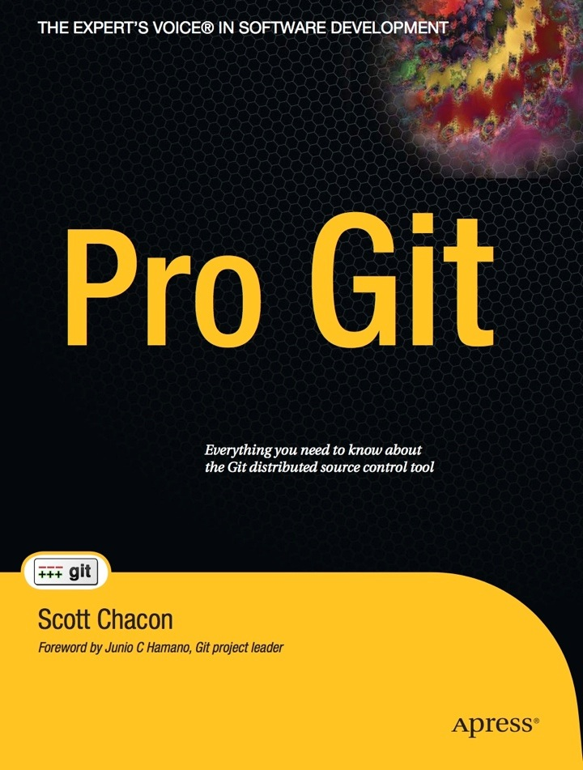
Homework
Watch “Getting Git” by Scott Chacon http://vimeo.com/14629850 (A one hour presentation about GIT)
Read Chapter 2 of “Pro Git” by Scott Chacon.

Slide 58
Concepts (1/2)
GIT is a Distributed Version Control System
The workspace has a local repository which can be synced with remote repositories.
Repositories don’t have to be exact copies.
Repositories are propagating changes by push, pull, or patches.

Slide 59
Concepts (2/2)
GIT stores complete snapshots for commits, duplicates are omitted by references.
References are generated through hashing the content (SHA1).
GIT stores all data in four different objects: blob, tree, commit, tag.

Slide 60
Credits
Git flow picture: Vincent Driessen http://nvie.com/posts/a-successful-git-branching-model/

